Slide 1
HEAT ENGINE
Heat Engine is the device in which
The Chemical Energy of the Fuel(Air Fuel mixture) is converted into
Thermal Energy (Heat)
Mechanical Work (Crank Shaft Rotation)

Slide 2
Heat Engine
Steam Engines or Steam Turbine
1 Heat is transferred to secondary fluid (working fluid)
2. Steam is generated
3. Steam is used in piston engine or turbine
Gas Turbine
1. Secondary fluid is gas or air
Internal Combustion Engines
Product of combustion is motive fluid
4- stroke
2- stroke
etc
External Combustion Engine

Slide 3
Classification of I.C. Engine
Based on number of stroke per cycle.
a) four stroke cycle engine
b) Two stroke cycle engine
Based on cycle of combustion.
a) Otto cycle engine
b) Diesel cycle engine
c) Dual combustion cycle engine
Based on number of cylinder
a) Single cylinder engine
b) Multi-cylinder engine

Slide 4
5) Method of ignition of fuel
a) Spark ignition (S.I) engine
b) Compression ignition (C.I) engine
6) Based on fuel used
a) Gasoline or petrol engine
b) Diesel oil engine
c) Compressed Natural Gas
d) gas engine etc.
7) Method of cooling the cylinder
a) air cool engine
b) Water cool engine

Slide 5
8) Based on fuel supply system
a) Carburetor engine
b) Air injection engine
c) solid injection engine
9) Their uses
a)Stationary engine
b) portable engine
c) Marine engine
d) Automobile engine
e) Tractor engine

Slide 6
Internal Combustion Engines
Combustion: inside the cylinder with air inducted from atmosphere.
The chemical energy of fuel released raises the pressure and temperature of the products of combustion.
These hot gases are substantially expanded to develop the mechanical power and rejected to atmosphere.

Slide 7
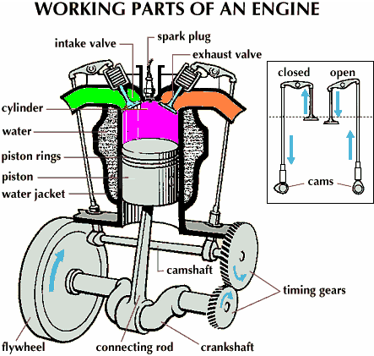

Slide 8
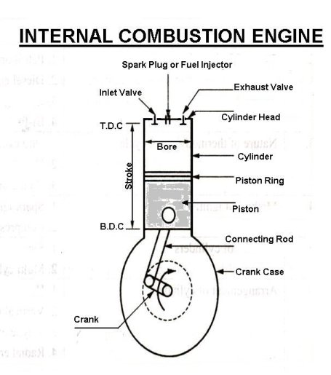

Slide 9
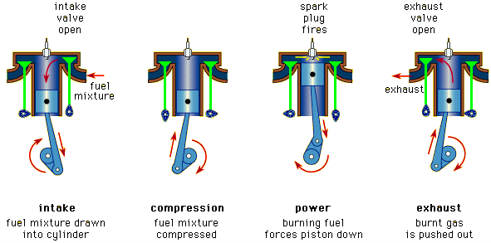
Working of Four Stroke S.I engines or
Petrol engine

Slide 11
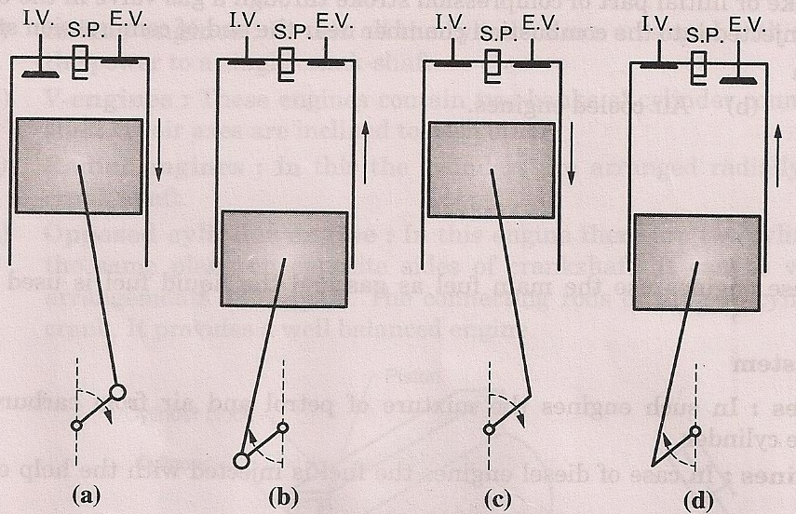

Slide 13
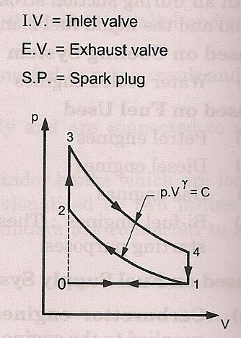
PV Diagram of Otto cycle
Each Stroke = 180⁰ Crank Rotation
Total Rotation of Crank Shaft: 720 ⁰
0-1 suction takes place
1-2 Adiabatic compression
2-3 Heat Addition
3-4 Adiabatic expansion
4-1 heat rejection
1-0 exhaust process

Slide 14
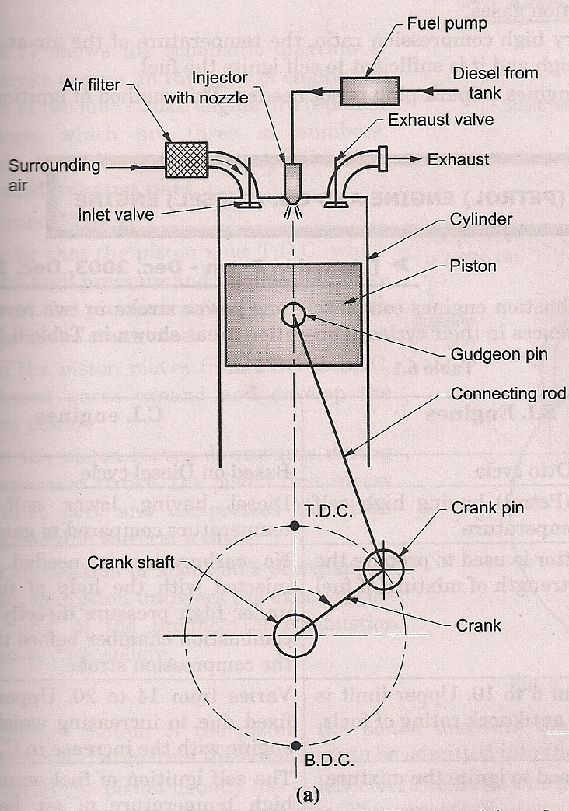
Working of Four Stroke C.I engines or Diesel engine

Slide 15
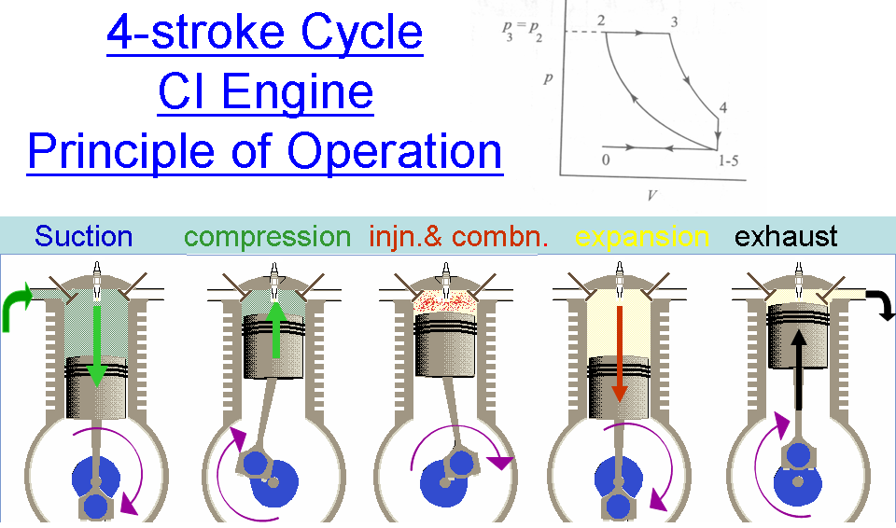
injector
injector
injector
injector
injector

Slide 16
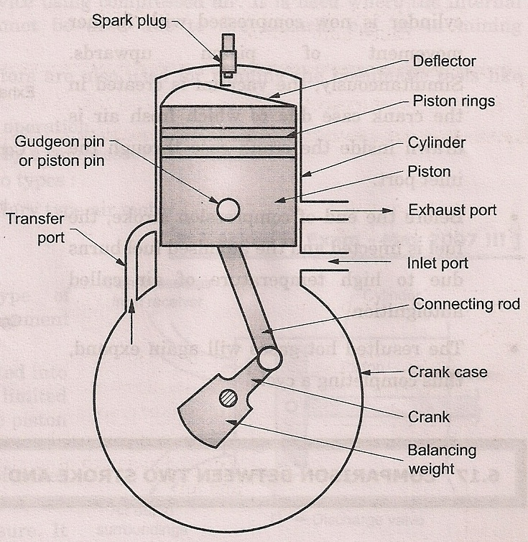
Two stroke S.I. Engine

Slide 17
2-STROKE ENGINE

Slide 18
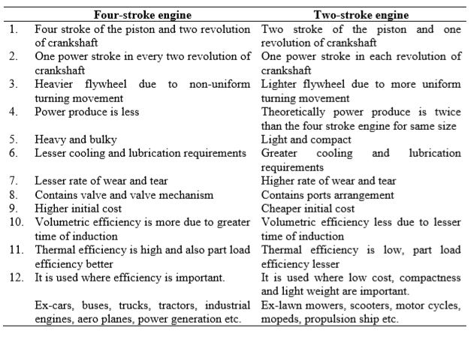
Comparison of Four-stroke and two-stroke engine

Slide 19
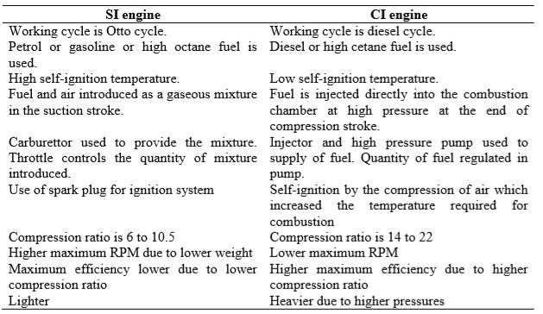
Comparison of SI and CI engine

Slide 20
CNG Engine
Compressed Natural Gas is one of the popular fuel used now a days due to its low cost & eco-friendliness.
Mainly in CNG, methane gas (CH4) is used in a compressed state so that more amount of gas can be accommodated inside the cylinder. This will increase the range of the distance travelled.

Slide 21
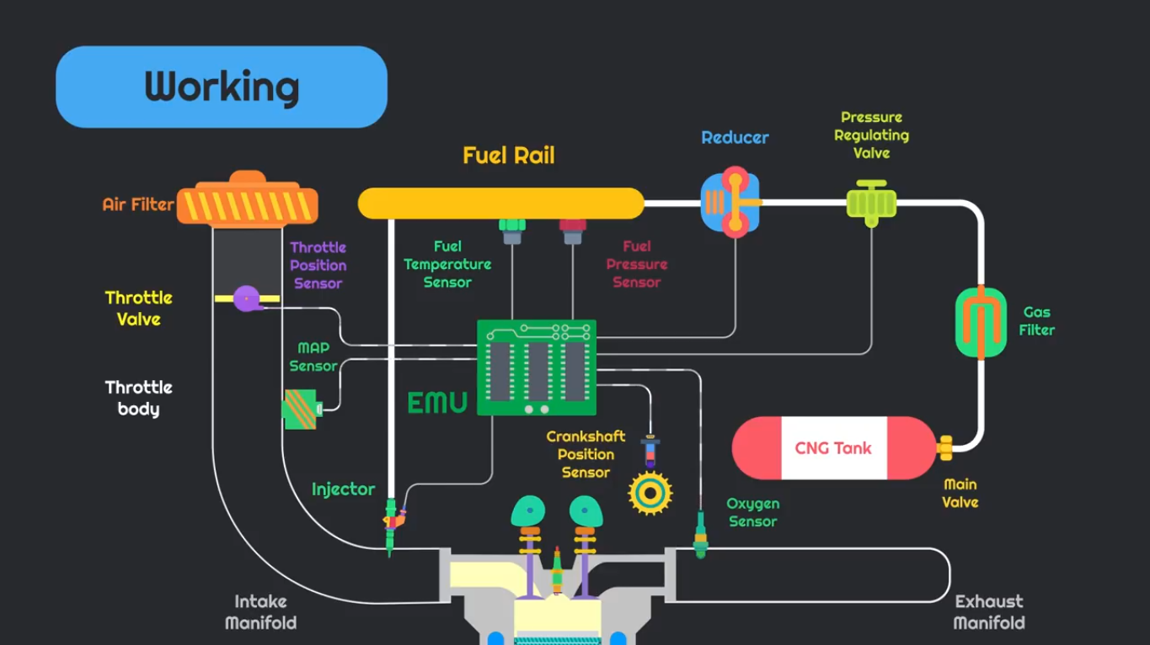

Slide 22
Manifold absolute Pressure(MAP)sensor
The Manifold Pressure Sensor is used in an engine's electronic control system.
Engines that use a pressure sensor are typically fuel injected.
The sensor provides instant manifold pressure information to the engine's electronic control unit.
The data is used to calculate air density and determine the engine's air mass flow rate, which in turn determines the required fuel delivery for perfect combustion.

Slide 23
Throttle Position Sensor(TPS)
A throttle position sensor (TPS) is used to monitor the throttle valve position in internal combustion engines.
TPS is usually located on the throttle valve spindle so that it can directly monitor its position.
TPS gives to the onboard controller information about the idling, deceleration, rate of acceleration and the fully open throttle valve state.

Slide 24
Camshaft Positioning Sensor
A camshaft position sensor is an electronic device that does what it suggests —
monitor the camshaft position and speed and feeds that data to the vehicle’s engine control Unit (ECU).
The ECU needs this data to control how much fuel enters the combustion chamber and ignition (spark) timing to ignite the fuel.

Slide 25
Fuel Temperature & Pressure Sensors
Fuel Temperature Sensor (FTS) is designed to measure the temperature of a vehicle's fuel and relay this information to the engine control unit,
so that it can optimize the air-to-fuel mix ratio, depending on what the fuel temperature is with respect to the intake air temperature.
The fuel pressure sensor senses the amount of fuel in the fuel rail by reading the internal pressure of the rail. It can then send an electronic message to the PCM telling it precisely how much fuel needs to be released into the engine.

Slide 26
Oxygen Sensor
The Oxygen sensor is part of the emissions control system and feeds data to the­ Electronic Control Unit.
The goal of the sensor is to help the engine run as efficiently as possible and also to produce as few emissions as possible.
Th­e oxygen sensor is positioned in the exhaust pipe and can detect rich and lean mixtures.
The ECU determine if the mixture is rich or lean and adjusts the amount of fuel entering the engine accordingly.

Slide 27
Advantages OF CNG
Affordable for common people in cost compare to other fuels such as Petrol, Diesel etc.
Lower Maintenance cost.
Pollution free Environment.(Eco Friendly)
Increased Milage
CNG less likely to ignite on hot surfaces(safe)
CNG fuel systems are sealed, Preventing fuel loss from spills or evaporation.
Doesn’t affect the engine parts, compared with diesel.

Slide 28
Limitations Of CNG
CNG Vehicle needs more space for fuel storage.
Starting problem in cold Weather conditions
Installation cost is high.
Limited availability of natural gas stations
CNG vehicles have lower power output than petrol engine (Low pick up )
Additional weight of CNG cylinders causes problem.

